Slide 1
Using Earth Science Data and Technology to Mitigate the Dangers of Airborne Volcanic Ash
AGU-NESTA Geophysical Information for Teachers (GIFT) Workshop
Volcanoes
History and Types
Peter Webley
Geophysical Institute, UAF

Slide 2
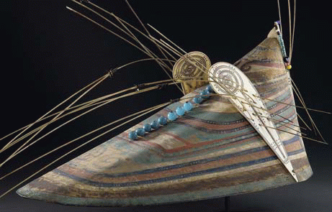
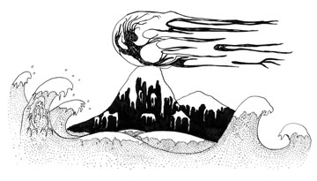
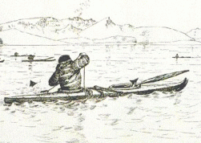
The History of Volcanology: Mythology
Chuginadak: The Unangan goddess of fire
The Aleutian Islands are home to many volcanoes. Chuginadak, the goddess of fire, is said to have thrown the first man and woman from the summit of her mountain into the sea.

Slide 3
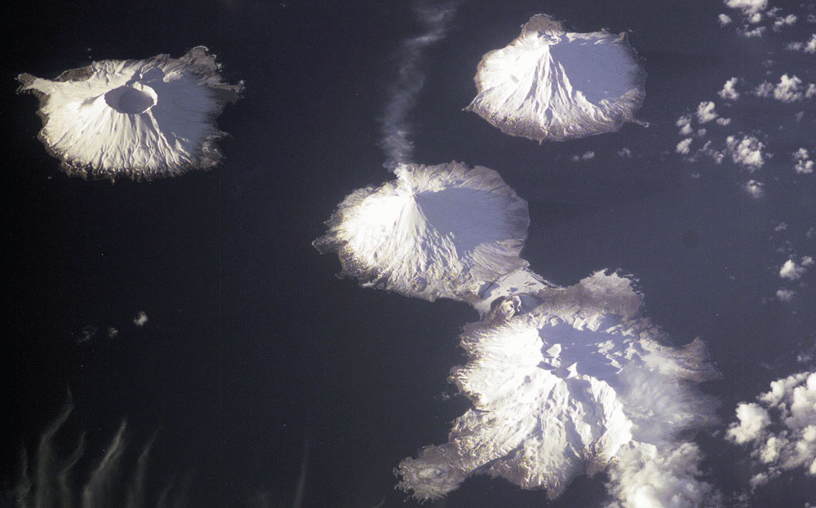
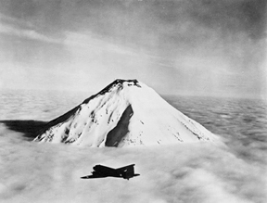
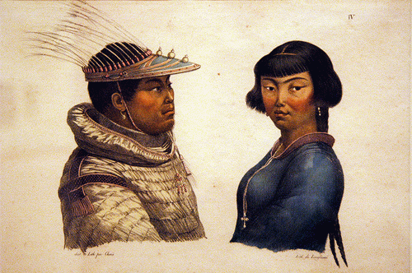
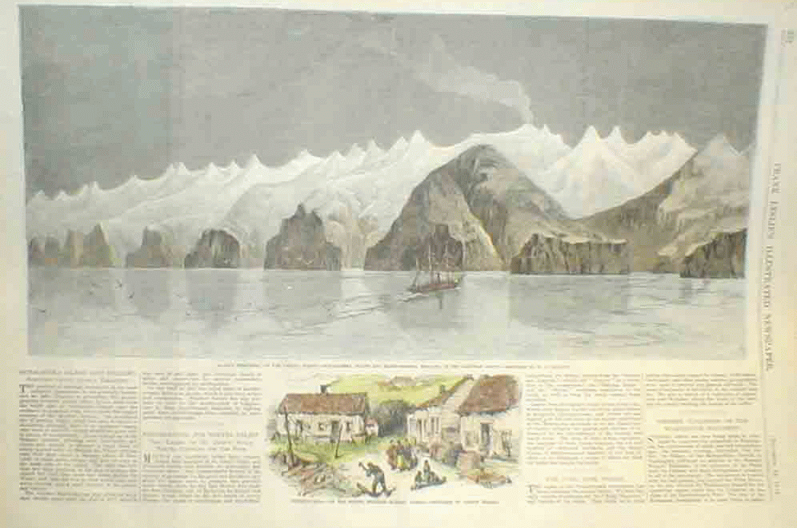
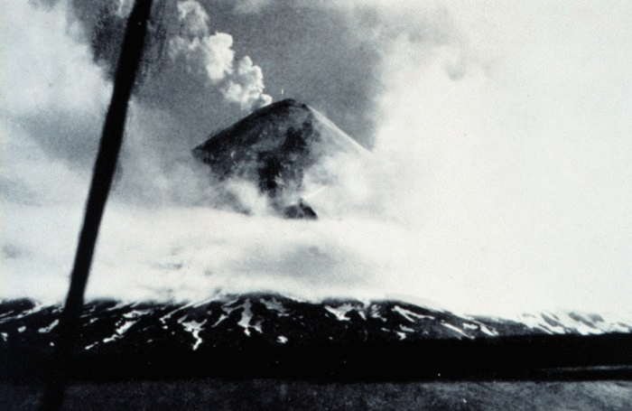
The History of Volcanology: Mythology
Chuginadak: The Unangan goddess of fire
Much of the Unangan culture was lost through invasion and war. Today Cleveland volcano remains a holy place for the Unangan people.

Slide 4
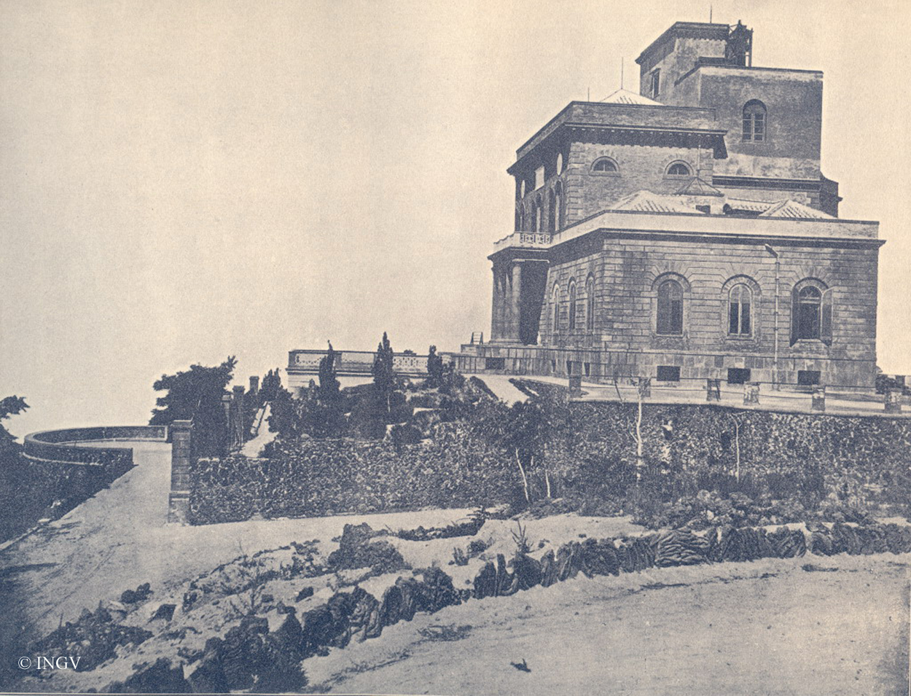
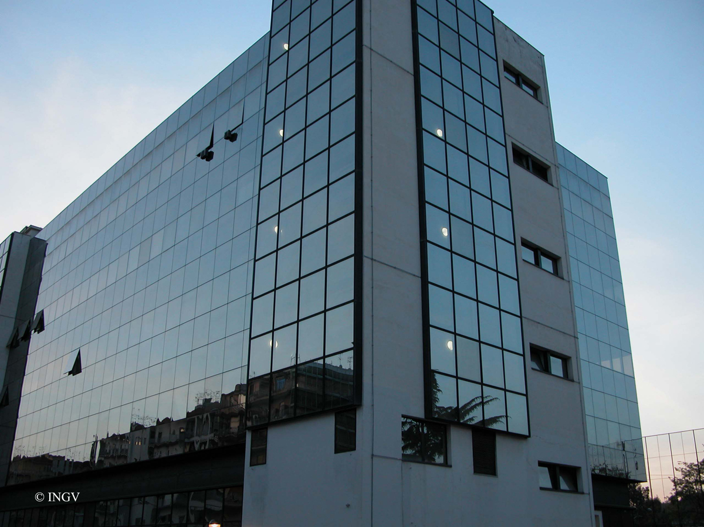
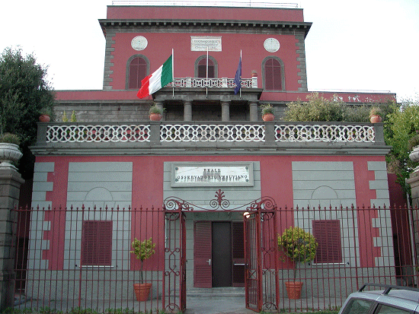
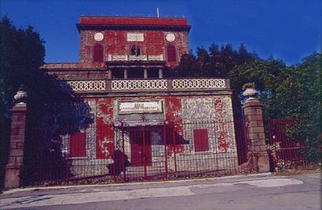
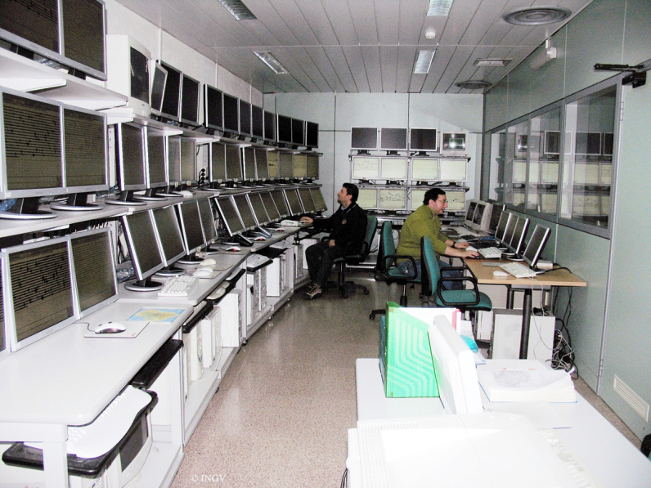
The History of Volcanology: Science
The first volcano observatory was:
Osservatorio Vesuviano
in Naples, Italy. It focused on recording the activity and providing warnings to the populace at Mount Vesuvius.

Slide 5
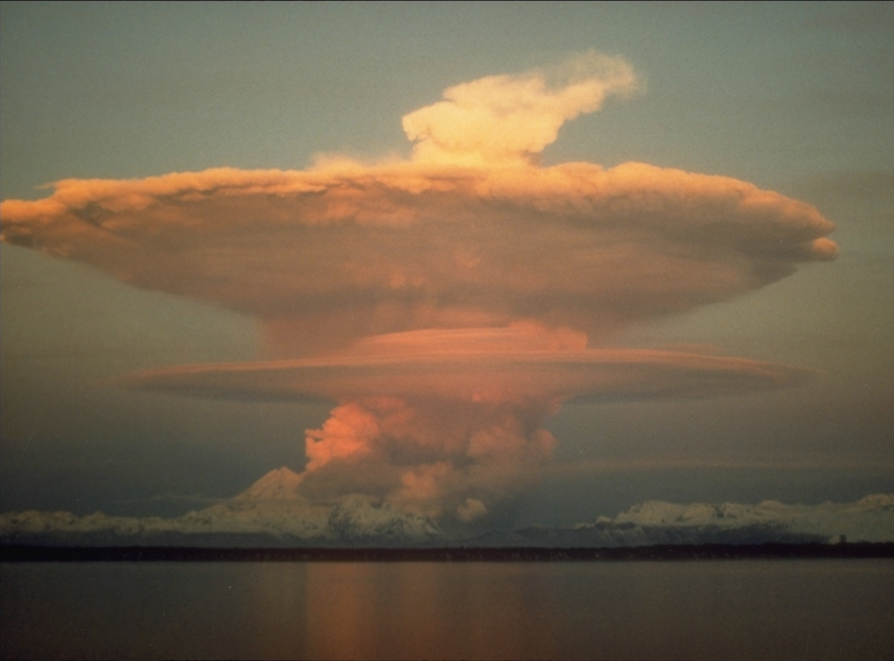
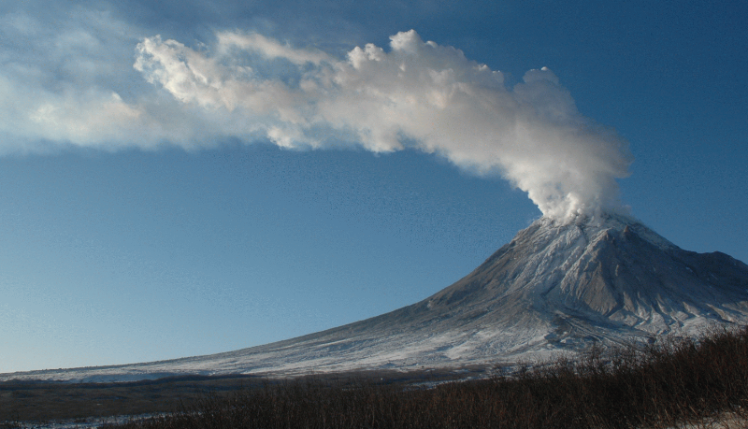
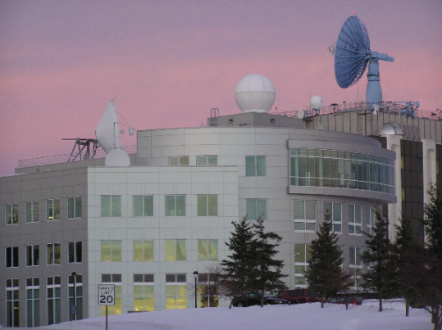
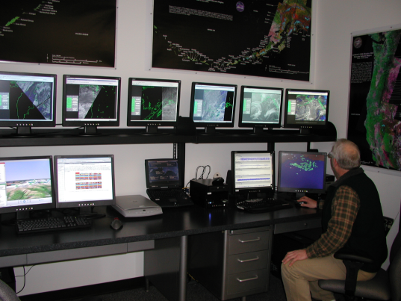
The History of Volcanology: Science
Today the Alaska Volcano Observatory is recognized by many as the world leader in volcanology.
AVO is the first observatory to use infrared imaging in its day to day operations.

Slide 6
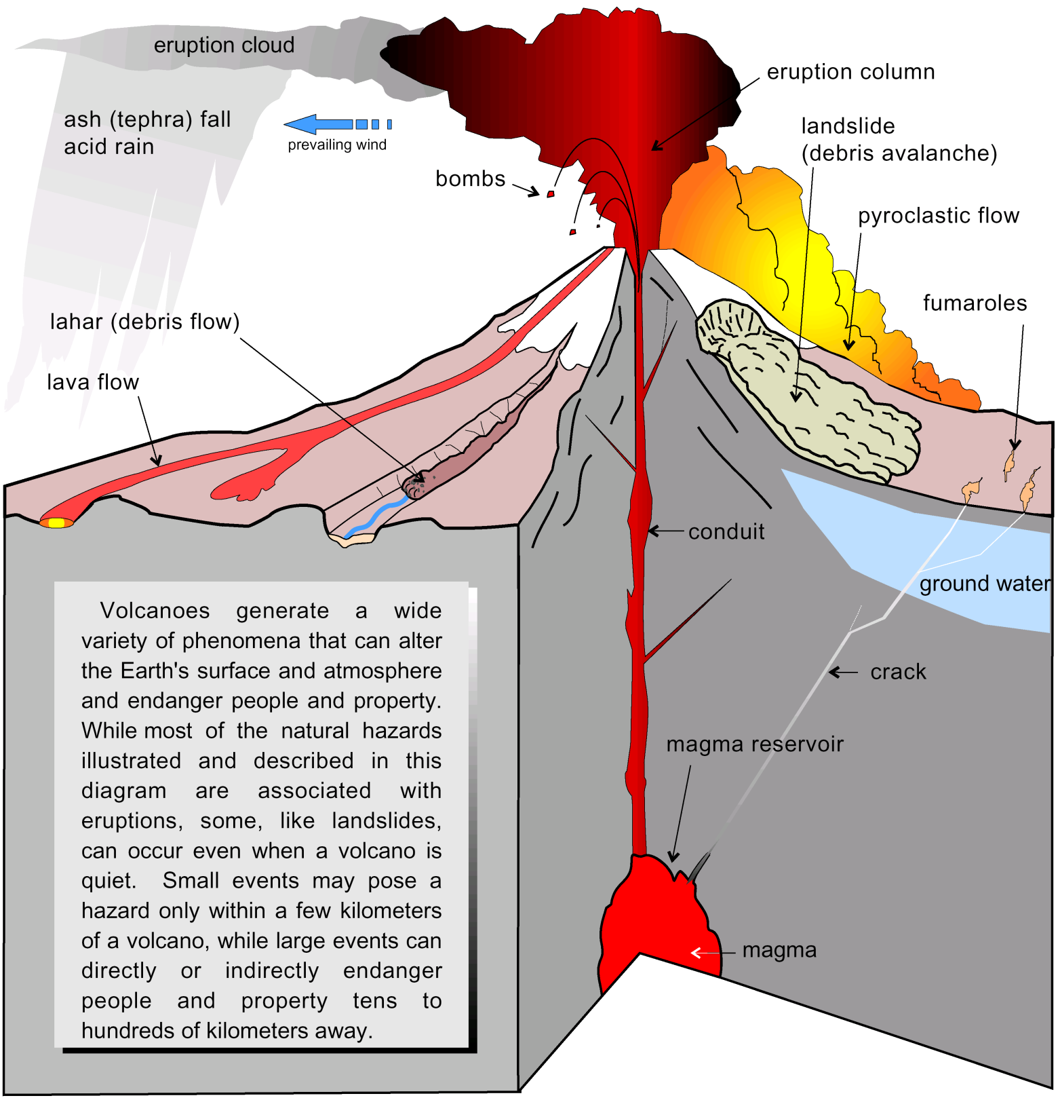
Volcanoes present hazards not only to local residents, but can have far reaching and long term environmental effects.
Volcanic processes begin in the crust, and as they approach the surface have more and more visible effects.
Magmatic effects
Surface effects
Atmospheric effects

Slide 7
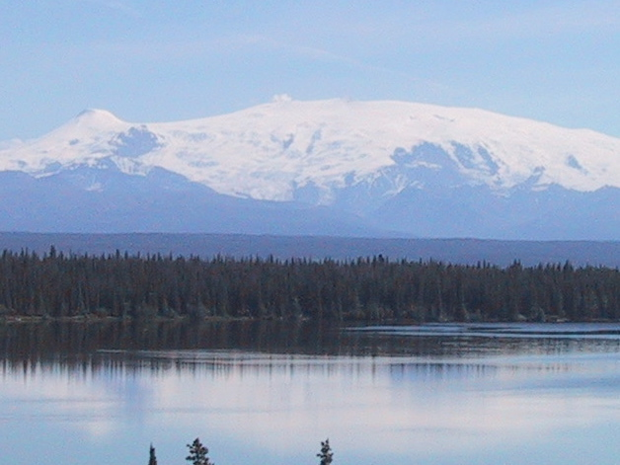
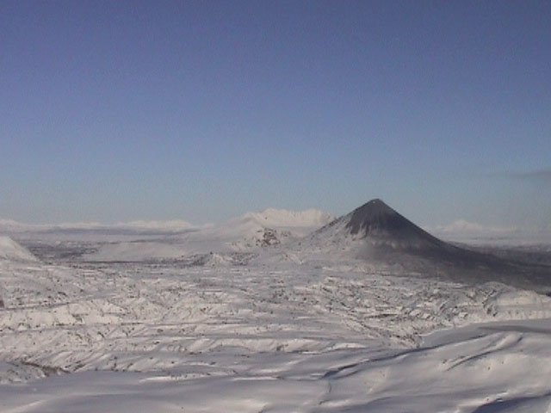
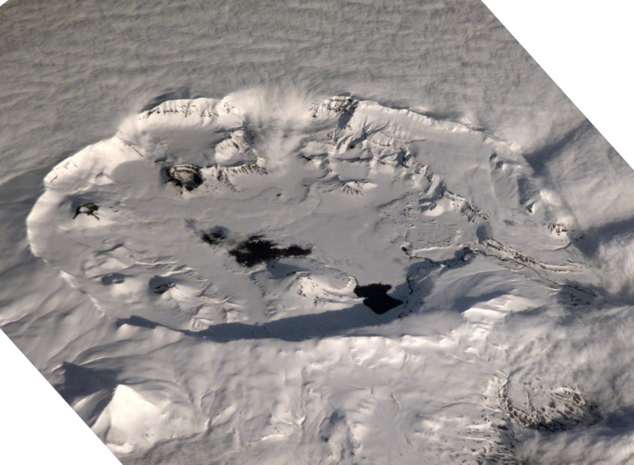
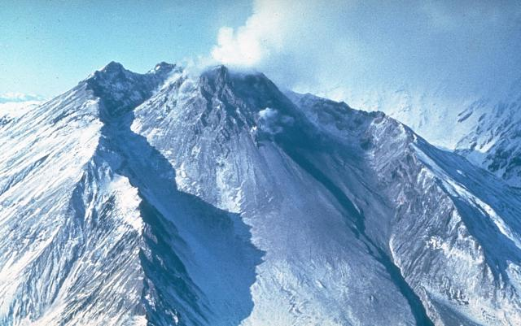
Types of Volcanoes in Alaska and Kamchatka
Shield Volcano
Stratovolcano
Mt. Wrangell
Karymsky V.
Caldera
Dome
Okmok, Space Station
Bezymianny V.

Slide 8
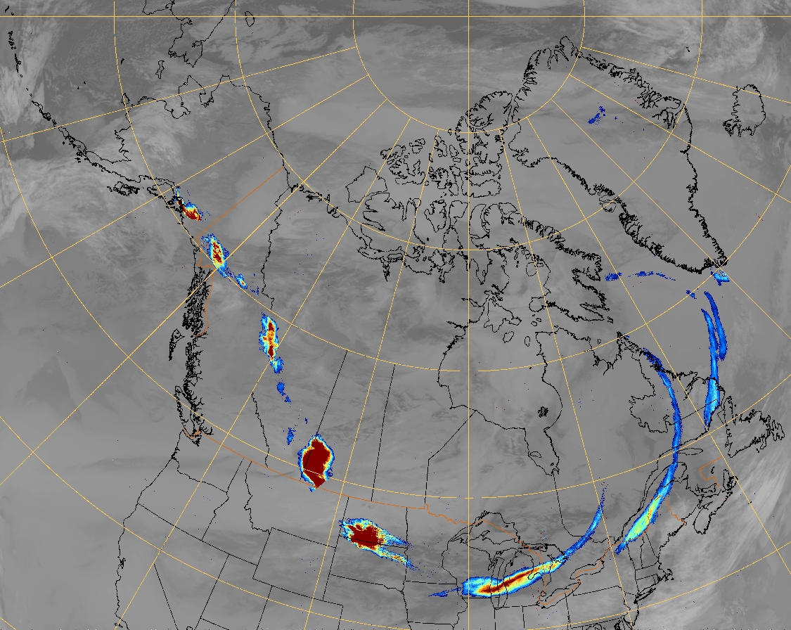
Spurr 1992 Volcanic Cloud : tracked to Greenland

Slide 9
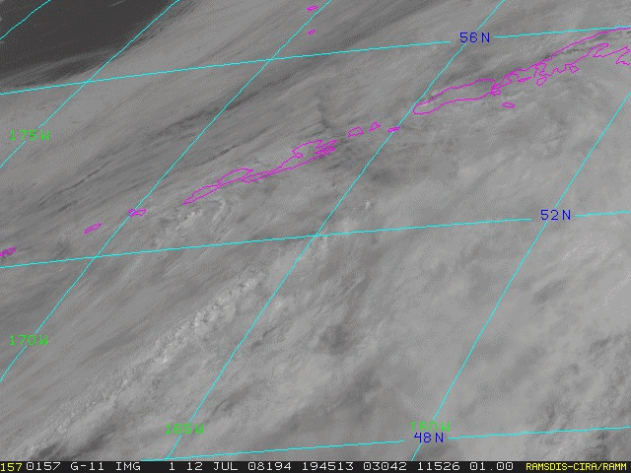
Okmok Volcano, Alaska

Slide 10
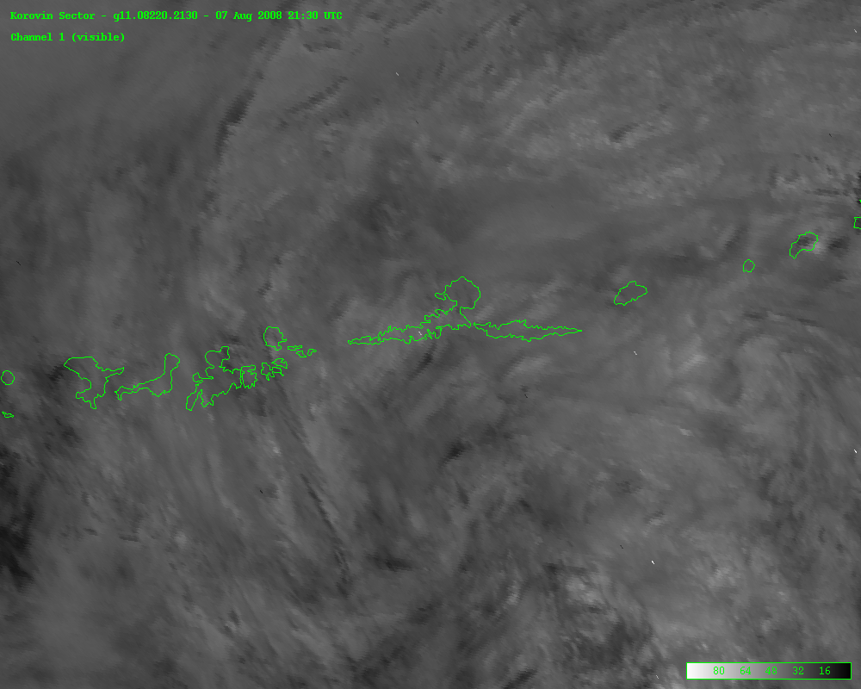
Kasatochi Volcano, Alaska

Slide 11
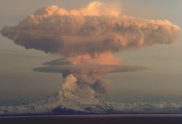
A KLM 747 en route from Amsterdam
encountered an ash cloud from Redoubt Volcano

Slide 12
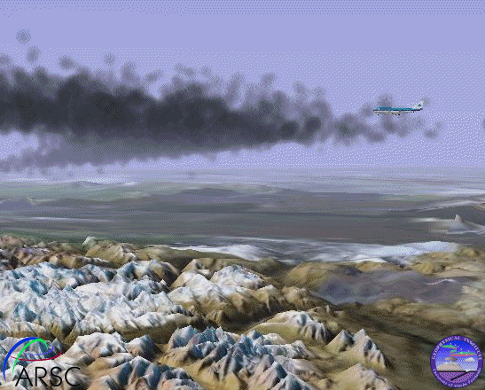
Pilot: KLM B-747
“KLM 867 heavy is
reaching {flight} level
250 heading 140.”

Slide 13
Anchorage Center
“Do you have good
sight of the ash plume
at this time?”

Slide 14
Pilot: KLM B-747
“It’s just cloudy it
could be ashes.
Its just a little browner
than a normal cloud,”

Slide 15
Pilot: KLM B-747
“We have to go
left now…
it’s smoky in the cockpit at the moment sir.”

Slide 16
Anchorage Center
“KLM 867 heavy,
roger, left at your
discretion.”

Slide 17
Pilot: KLM B-747
Climbing to level
390, we’re in the
black cloud,
heading is130.”

Slide 18
Pilot: KLM B-747
“KLM 867 we have
flame out all engines
and we are descending
now.”

Slide 19
Anchorage Center
“KLM 867 heavy...
Anchorage.”

Slide 20
Pilot: KLM B-747
“KLM 867 heavy
we are now descending
now....
We are in a fall!!”

Slide 21
Pilot: KLM B-747
“KLM 867 we need
all the assistance you
have sir. Give us radar
vectors please.”

Slide 22
She got two engines restarted, making a safe landing in Anchorage. That pilot and plane are still in service today.

